Slide 1
Architecture Exploration (15 min)
John Leidel
David Donofrio
tactcomplabs.com

Slide 2
SST Architecture Exploration
SST is a “framework”, NOT a point simulation solution
Outlining your architectural hypothesis is key to developing a successful (and reproducible) simulation environment
Start with small experiments and verify correctness before scaling to more complex examples
When developing new simulation components, use existing components as examples!
Simulation questions:
Is the experiment application centric or architecture centric?
Is the goal to minimize runtime or maximize scalability?
Am I only concerned with memory performance?
Am I only concerned with network performance?
Does the instruction set matter?
Does the architecture or device even exist?

Slide 3
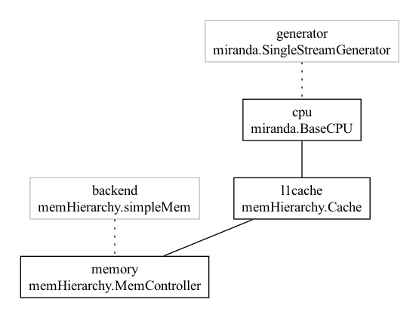
What is the performance of the memory system under the this access pattern?
In this case, trace based simulation inputs are likely the best path
Minimizes the overhead for examining statistical output
Easily reproducible
Simple composition of device components
Example:
Miranda memory trace generator
STREAM memory trace pattern
L1 Cache
memHierarchy memory controller
SimpleMem memory backend
https://github.com/sstsimulator/sst-elements/blob/master/src/sst/elements/miranda/tests/singlestream.py

Slide 4
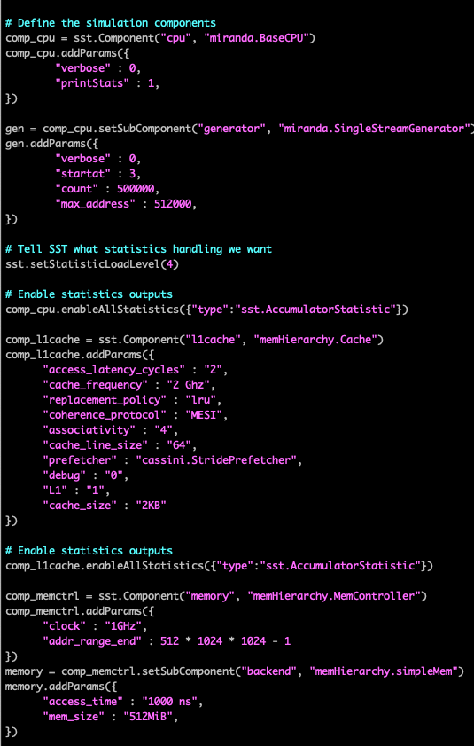
Trace Example
Change the cache clock frequency
Change the size of the cache
Add a cache layer
Change the backing memory performance

Slide 5
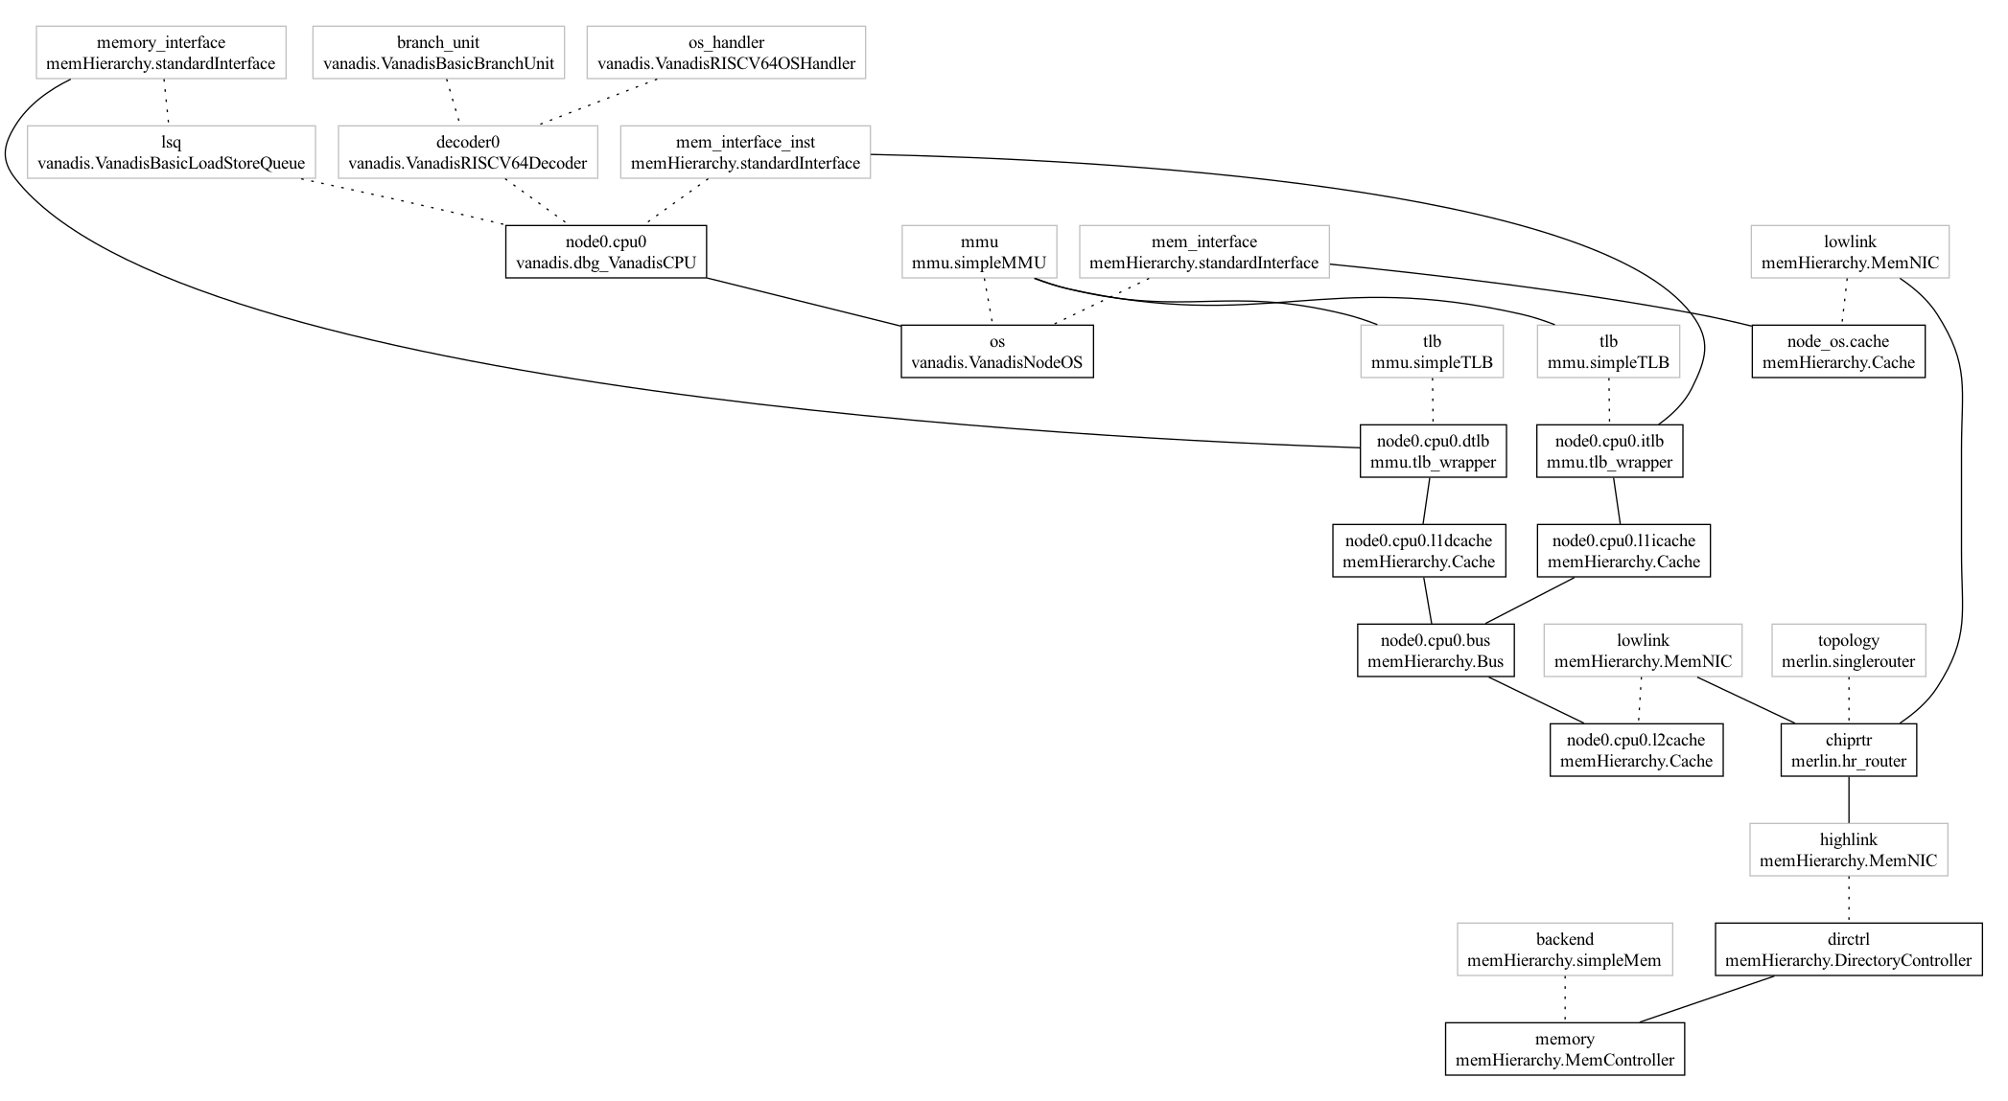
Start with condensed examples:
Single CPU Vanadis Simulation
Vanadis CPU
TLB
MMU
Directory Controller
Backing memory store
Notes:
Easily debug small simulations
Find connectivity issues
Determine approximate “node-level” runtime
Prepare your HPC resources to run at scale

Slide 6
Expand the condensed tests for full simulations
20 CPU Vanadis Simulation
https://github.com/sstsimulator/sst-elements/blob/master/src/sst/elements/vanadis/tests/basic_vanadis.py

Slide 7
Simulation Workflow (30 min)
John Leidel
David Donofrio
tactcomplabs.com

Slide 8
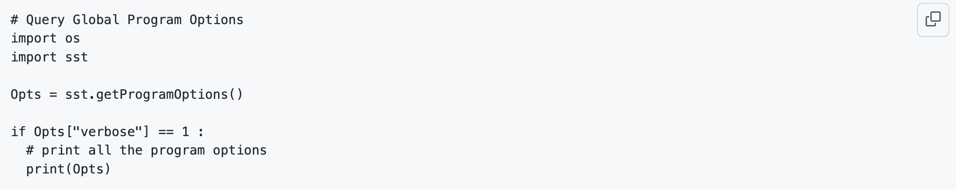
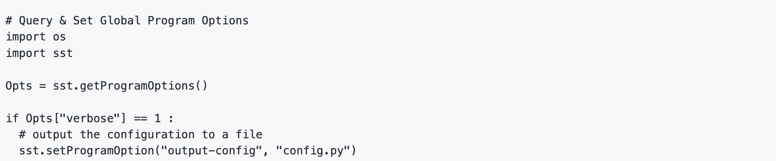
SST Python Program Options
The sst Python module can query and set global program options
Python scripts can retrieve the entire set of global program options (including the default values) as a dictionary
Often useful for ensuring the user input and/or configuration options are valid
Python scripts may also enable or override the program options

Slide 9
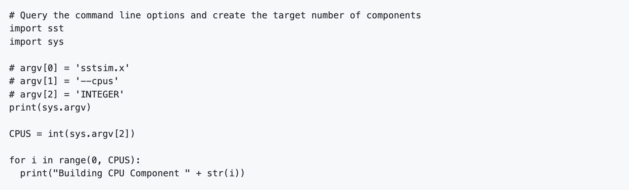
SST Python Model Options
SST also provides an interface to pass command line arguments to the Python environment
This requires the --model-options=“opt1 opt2” option
This requires the Python script to utilize the sys module, which provides the argc, argv lists
This allows users to build reusable Python scripts

Slide 10
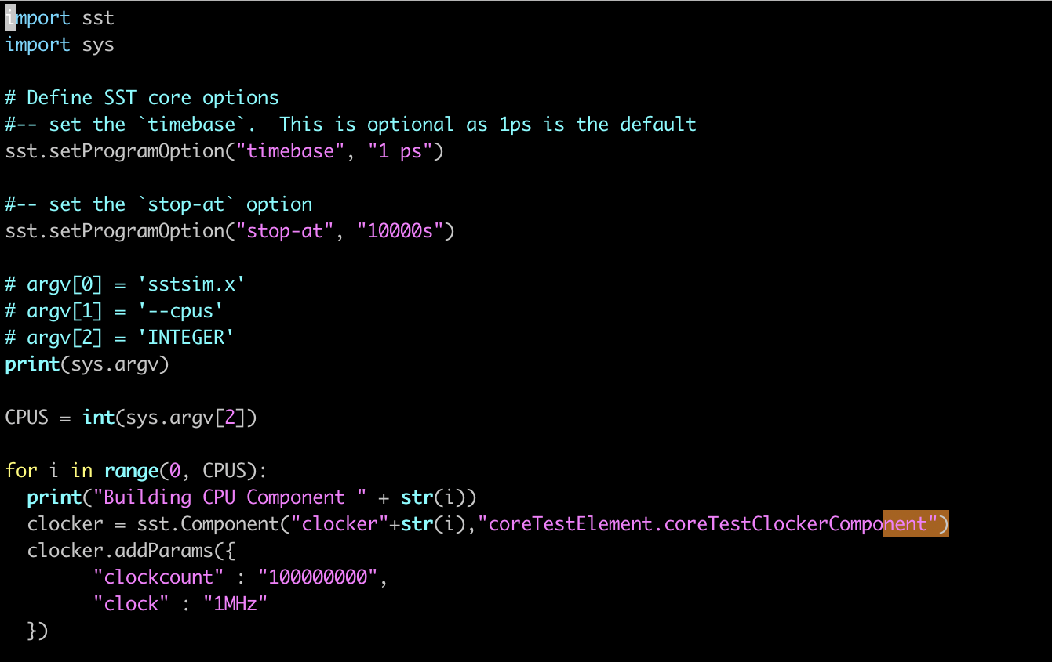
Example Python Model Options
$> sst --model-options=“--cpus 10” test_ClockerModelOptions.py

Slide 11
Expanding Python Inputs
Now that you can build more complex Python script inputs, it may be useful to utilize the SST infrastructure to create scalable simulation scripts
This feature allows us to input a condensed Python script and output a fully expressive script with all options expanded
This can be done explicitly or within our Python environment!
This allows us to:
Archive simulation models for future use that contain all the program arguments, component infrastructure and link connectivity within the script input
Hand tune specific rank/thread layout in order to improve performance
We will see how this may be also utilized with parallel loading later in the day to increase the performance of simulation startup
$> sst --model-options=“--cpus 10” \
--run-mode=init --output-config=expanded.py \
test_ClockerModelOptions.py

Slide 12
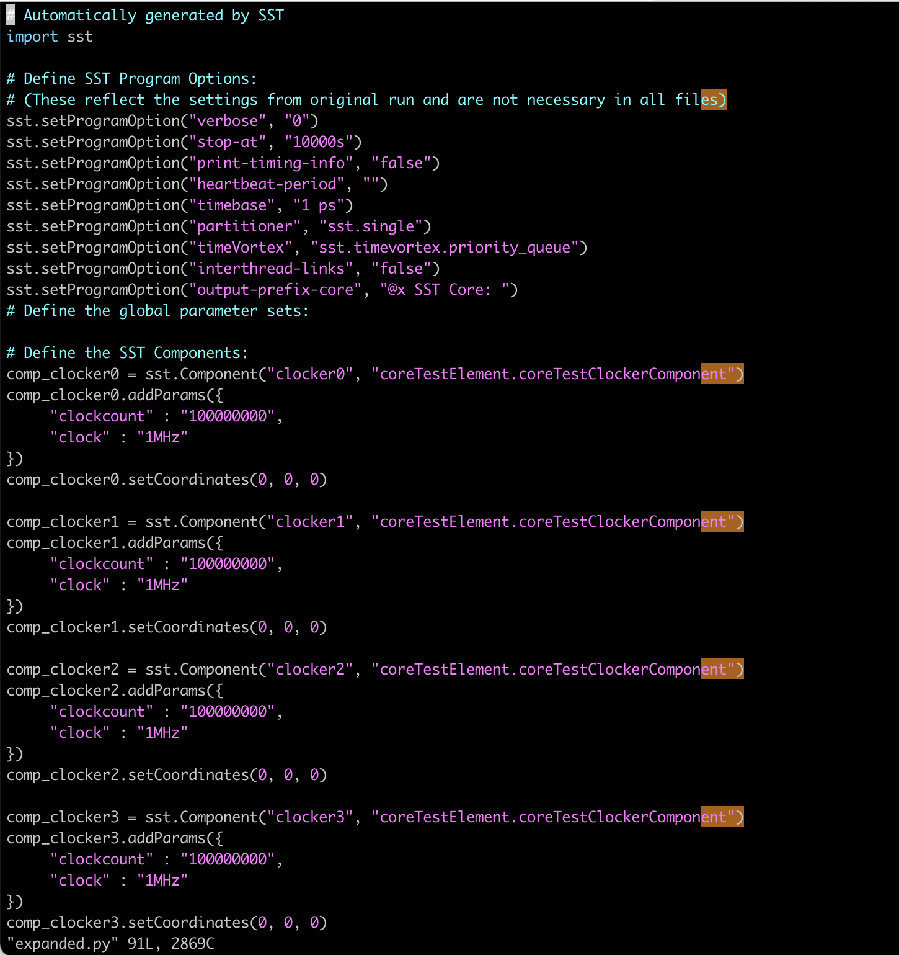
Expanded Python Output

Slide 13
SST JSON Inputs
With SST 12.0.0 JSON can now be used to describe simulation inputs
The SST JSON format supports:
Program options
Component attributes
Recursively nested subcomponents
Link configuration data
The SST JSON format does not currently support global statistics options
Component-level statistics options are supported
Pros:
Easier to read/write from external tooling (Python, etc)
Explicitly expanded to include all component data
Cons:
Not always human readable
Complex to create manually

Slide 14
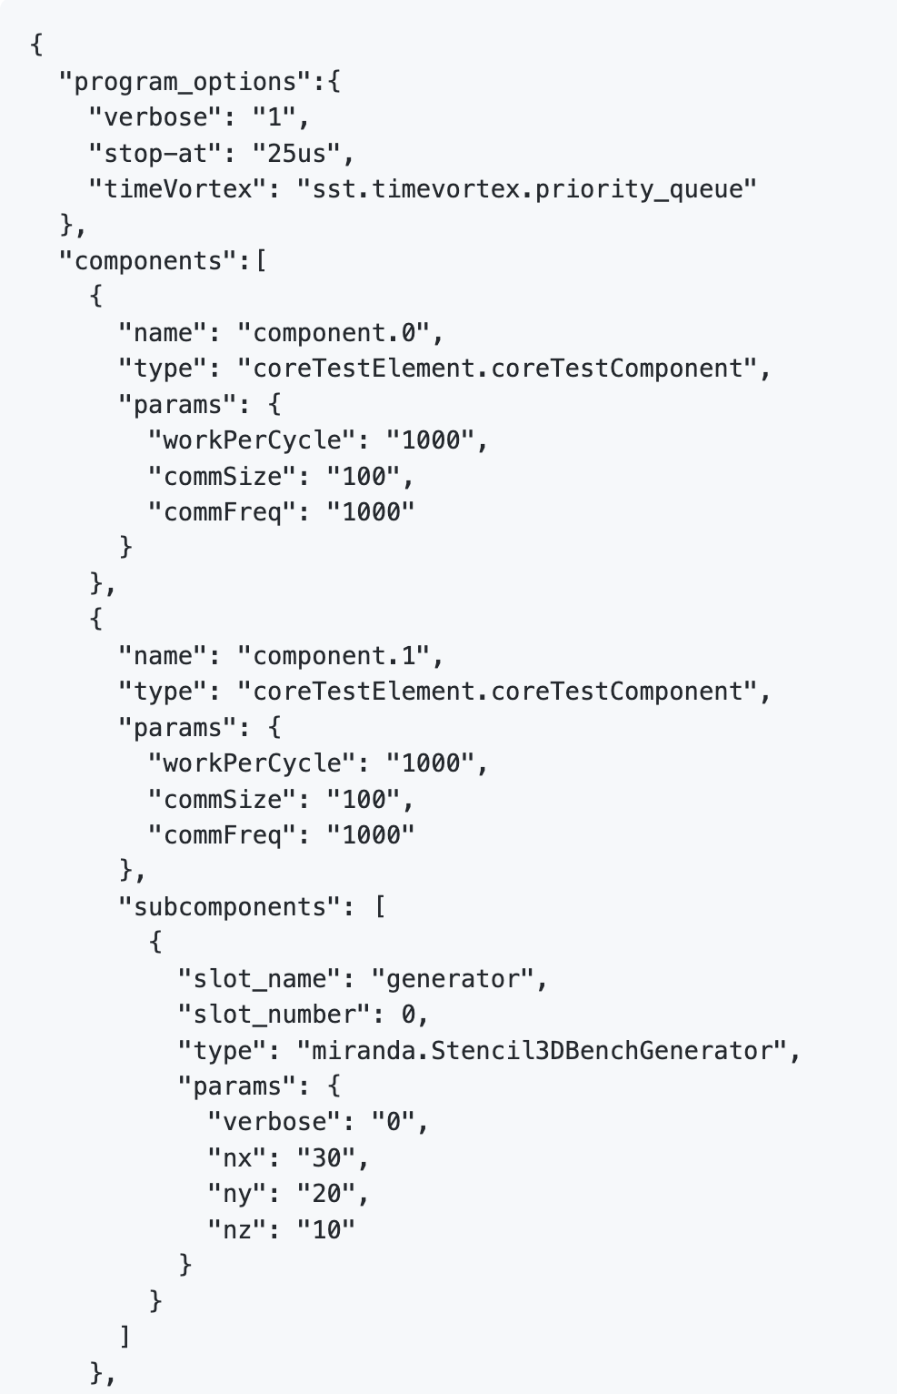
SST JSON Format
Program Options
Sample Component
Sample Component Parameters
Subcomponent List
Subcomponent
Subcomponent Parameters

Slide 15
Converting Between SST Formats
SST provides a convenient mechanism to convert to/from SST input styles
Users can write complex Python inputs (loop flow control, etc) and output the Python in JSON
Similarly, users can ingest JSON and output Python
$> sst --run-mode=init --output-json=sample.json \
test_ClockerComponent.py
$> sst --run-mode=init --output-config=sample.py \
sample.json

Slide 16
Parallel Execution Tuning
In SST 15.0.0, MPI-centric parallelism will generally perform better for network intensive simulations
Threading performance is improving dramatically
Pay special attention to component constructor/init costs
Constructing complex components with large memory allocators in the constructor/init routines will slow down initialization
Graph construction time can consume a large memory footprint on rank=0
Parallel graph loading can reduce memory footprint and startup time
Manual partitioning can improve performance/throughput
This is often due to the naïve partitioner. When running with many disparate components whose link latencies are similar/identical, it may be necessary to hand tune the component/link partitioning
Do not utilize debug/profiling modes for large scale simulation
The debug and profiling modes will have a dramatic effect on performance of large scale simulations

Slide 17
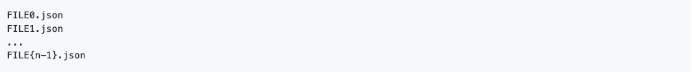
Parallel Graph Loading
SST achieves this by allowing users to specify N simulation input files for N parallel execution units
Constraints:
One simulation input file per parallel unit, File0.json, File1.json, … File{n-1}.json
All simulation files must contain the same program_options
Any simulation components contained in an N’th input file but not assigned to that rank will be ignored
“Ghost” components must be created in order to ensure that links that span ranks are fully connected
Parallel input parsing must be specified at runtime: --parallel-load=OPT
OPT can be SINGLE or MULTI; SINGLE sends the same input file to all ranks; MULTI sends individual files to individual ranks
SINGLE mode must specify rank data for every component
Sample of MULTI usage

Slide 18
Converting Between Sequential and Parallel Graphs
Existing single Python and JSON inputs can easily be converted to parallel, pre-partitioned files using SST
Utilize the --run-mode option alongside the --parallel-output and --output options
$> mpirun --hostfile output.txt -n 2 \
sst --run-mode=init --parallel-output=1 \
--output-json=test.json test.py
$> ls test*.json
test0.json
test1.json

Slide 19
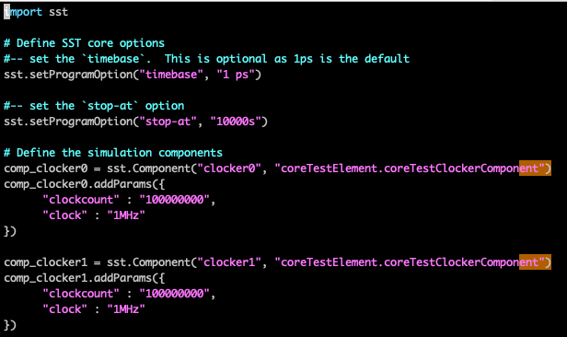
Sample Parallel Conversion
$> mpirun --hostfile output.txt -n 2 \
sst --run-mode=init --parallel-output=1 \
--output-json=test_ClockerComponentParallel.json \
test_ClockerComponentParallel.py

Slide 20
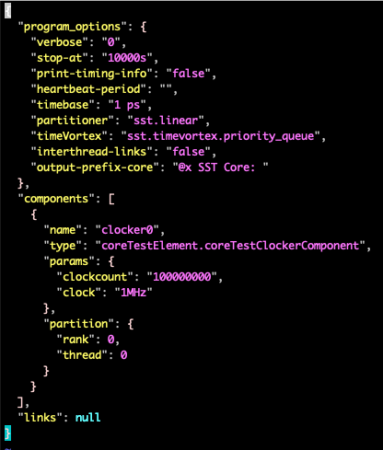
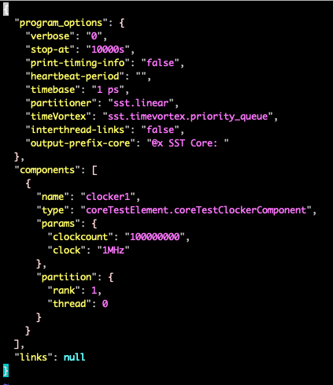
Sample Parallel Conversion Output
test_ClockerComponentParallel0.json
test_ClockerComponentParallel1.json

Slide 21
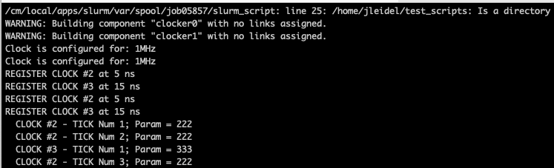
Sample Parallel Execution
$> mpirun --hostfile output.txt -n 2 \
sst --parallel-load=MULTI \
test_ClockerComponentParallel.json

Slide 22
Experimental Methodologies
Depth Modeling
Breadth Modeling
Question: What is the optimal architecture configuration for kernel X?
Process:
Develop a baseline model
Execute the model and record the statistical output
Select a single parameter to scale and sweep the parameter through various options and record the simulation output (EG, clock frequency, memory latency, cache size, etc)
Select a second parameter and continue the process
Question: What is the scalability of architecture X with respect to kernel Y?
Process:
Develop a baseline model
Execute the parallel model and record the statistical output
Scale the model and/or kernel size (strong and weak scaling)
Record the incremental statistical outputs and simulated timing

Slide 23
Modeling RISC-V Architectures with Rev (60 min)
John Leidel
David Donofrio
tactcomplabs.com

Slide 24
Rev Section Overview
What is Rev?
Rev architecture & installation requirements
Building & running sample experiments
Extending Rev with custom instructions

Slide 25

What is Rev?
Rev is a cycle-based CPU simulation component built specifically to execute within SST
Bare metal simulation infrastructure
Load & executes ELF binaries
Supports interfacing with external memory components (caches, backing memory stores, etc)
Supports interfacing with external network components (Merlin)
Reasonable instruction performance
~ 3 MIPS
https://github.com/tactcomplabs/rev

Slide 26
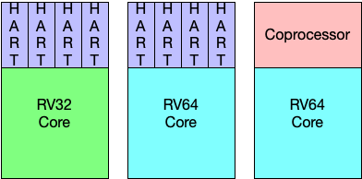
Rev Features
Support for RV32 and RV64G XLENs
Supports extensions:
Open source: IMAFDC, Zicbom, Zaamo, Zalrsc, Zfa, Zicsr, Zifencei
Closed source: RVV
Support for multi-core, multi-hart and multi-core + multi-hart
Support for heterogeneous SoC’s
Support for user-defined coprocessors
Easily extensible for custom ISA extensions

Slide 27
Rev Extensibility
Extensions are defined using a prebuilt table-generated interface
Tables feed the crack + decode interface as well as the individual instruction implementations
Adding extensions is a well-defined, documented process
Extensions are not required to handle explicit decoding, hazarding or other arbitration logic
Each instruction can reside in the pipeline for a user-defined period (can be set dynamically at runtime)
User-defined coprocessors can be loaded as shared library objects to implement non-standard RISC-V functionality
Coprocessors are handled via unimplemented instruction traps
Coprocessors can support non-standard RISC-V encoding, but maintain access to register state and memories

Slide 28

Rev extensibility
Rev has been utilized for the IARPA AGILE program to simulate large-scale HPC systems
We have constructed models that interface with custom coprocessors, external accelerators, NoCs, RDMA networks and complex memory hierarchies
Initial scalability tests have evolved to simulations exceeding 78,000 Rev CPUs connected to memories and networks
Largest SST simulations to date
Largest RISC-V simulations to date
https://www.iarpa.gov/research-programs/agile

Slide 29

Rev extensibility
Rev has also been utilized to study how various different styles of hardware faults may affect performance, reliability and numerical correctness
Rev supports injecting random faults into the pipeline logic, register file(s) and/or the memory subsystem with single or multi-bit errors
This work was done in conjunction with NASA in order to study how well rad-hard or semi-rad-hard RISC-V devices would perform in spaceflight operations

Slide 30
Rev architecture overview
Rev is written in C++-17 using the standard set of SST component/subcomponent interfaces
Rev is composed of multiple internal classes to support:
Binary loading (ELF)
Instruction (extension) implementations
Pipelined execution
Backing memory storage
Hazarding
System calls & threading

Slide 31
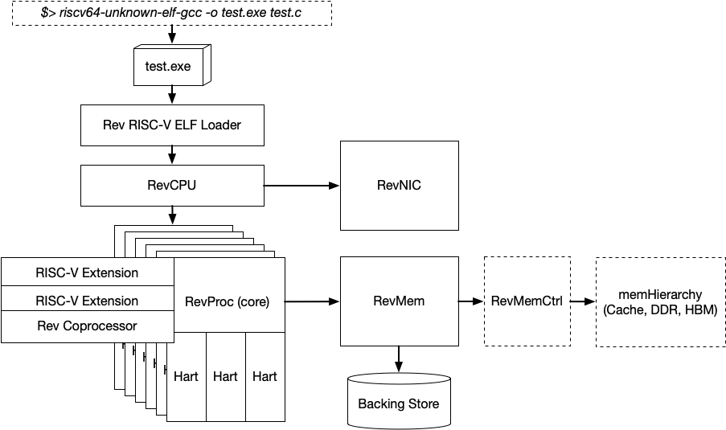
Rev Architecture
Rev executes within the SST simulation framework
Accepts ELF binary payloads compiled with GCC+Newlib or LLVM+MUSL
Multiple cores (procs) can be configured, each with unique RISC-V extensions
Each core can have multiple harts
The default memory behavior is a simple (fast) delay timing model (RevMem)
We also support cycle-based cache and memory timing using memHierarchy
We support an open source, basic NIC device for communicating with Merlin networks

Slide 32
Rev Architecture Cont.
Rev has been tested using a variety of C/CXX applications, benchmarks, etc
We do not support executing native Python or other interpreted languages
Binaries need to be statically linked
Each instance of Rev is single threaded
Multiple instances of rev can be executed in parallel across CXX threads and/or MPI
System calls are supported
Standard system calls marshal data to the host system for I/O, device access
Some system calls require shim interfaces in the user code
Additional system calls can added to support RDMA, MMIO, etc
Rev contains a coprocessor interfaces to build support for non-standard extensions, instructions, etc
Users can define their own coprocessors w/o directly modifying the core Rev source base

Slide 33
Building Rev
Requirements
CMake 3.19+
RISCV Compiler (riscv-gnu-toolchain)
C++ 17 compiler
SST (multiple versions are supported)
Building Rev
The devel branch is the most up to date
git clone
git config core.hooksPath .githooks
cd rev/build
cmake -DRVCC=/path/to/riscv/c/compiler/exe \
-DRVCXX=/path/to/riscv/c++/compiler/exe ..
make -j
make install

Slide 34
Building Experiments
Rev currently supports RISC-V RV32 and RV64 binaries that are statically linked
riscv64-unknown-elf-gcc -march=rv64gc -o cache_2.exe cache_2.c -static
There are a few exceptions:
System Calls:
Rev currently operates akin to Spike, there is no OS, so all system calls are handled via shims
System calls are supported, but prefixed with ”rev_”.
EG: rev_write( STDOUT_FILENO, msg, sizeof( msg ) - 1 );
Requires an additional header: ~/common/syscalls/syscalls.h
Pthreads:
Requires the same header and prefix trick as with normal syscalls
Threading logic inside Rev is, by default, very simple (round robin threading)
We have examples of hardware accelerated barrel threading
https://github.com/tactcomplabs/rev/tree/devel/test/syscalls

Slide 35
Building Experiments cont.
Other things to be aware of:
Building complex applications with large library dependencies may be somewhat difficult
Utilizing large numbers of system calls for debugging (aka, printf) will slow down your simulation (just like a real system)
Building complex applications that require complex constructors (executed prior to main) will incur performance overheads. Rev begins execution from the main symbol by default. C++ applications with large constructor blocks must begin execution from _start

Slide 36
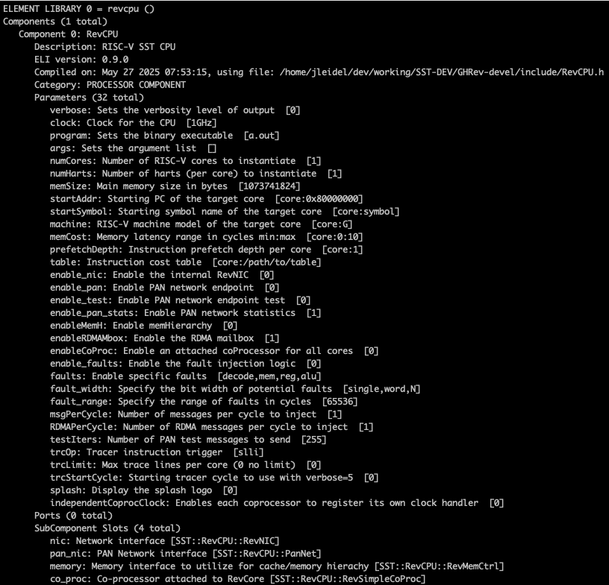
Building Rev Simulation Inputs
Rev simulation inputs are constructed using the same Python or JSON SDL file inputs:
sst-info revcpu
revcpu.RevCPU: core Rev CPU model
revcpu.RevBasicMemCtrl: basic memory controller subcomponent that supports the SST StandardMem interface (memHierarchy)
revcpu.RevNIC: basic NIC model that supports SST SimpleNetwork (merlin)
revcpu.RevSimpleCoProc: sample coprocessor subcomponent

Slide 37
Building Rev Simulation Inputs cont.
Option | Description
verbose | Sets the verbosity of the output. Defaults to “0”
clock | Sets the clock frequency of the Rev cores. Clock frequencies are homogenous across all cores + harts
program | Sets the path and name of the RISC-V executable
args | Sets the argument array for the executable.
numCores | Sets the number of cores for the RISC-V processor
numHarts | Sets the number of harts per core
memSize | Sets the size of the memory subsystem (in bytes)
startAddr | Sets the start address for each core: [0:0x12345678,1:0x234567] or [CORES:0x12345678]
startSymbol | Sets the start symbol for each core: [0:_start;1:main] or [CORES:main]
machine | Sets the machine extension model for each RISC-V core: [0:RV32I,1:RV64GC] or [CORES:RV64GC]

Slide 38
Rev Statistics
ReadInFlight: Counts the number of reads in flight, (units = "count") Enable level = 1
ReadPending: Counts the number of reads pending, (units = "count") Enable level = 1
ReadBytes: Counts the number of bytes read, (units = "bytes") Enable level = 1
WriteInFlight: Counts the number of writes in flight, (units = "count") Enable level = 1
WritePending: Counts the number of writes pending, (units = "count") Enable level = 1
WriteBytes: Counts the number of bytes written, (units = "bytes") Enable level = 1
FlushInFlight: Counts the number of flushes in flight, (units = "count") Enable level = 1
FlushPending: Counts the number of flushes pending, (units = "count") Enable level = 1
ReadLockInFlight: Counts the number of readlocks in flight, (units = "count") Enable level = 1
ReadLockPending: Counts the number of readlocks pending, (units = "count") Enable level = 1
ReadLockBytes: Counts the number of readlock bytes read, (units = "bytes") Enable level = 1
WriteUnlockInFlight: Counts the number of write unlocks in flight, (units = "count") Enable level = 1
WriteUnlockPending: Counts the number of write unlocks pending, (units = "count") Enable level = 1
WriteUnlockBytes: Counts the number of write unlock bytes written, (units = "bytes") Enable level = 1
LoadLinkInFlight: Counts the number of loadlinks in flight, (units = "count") Enable level = 1
LoadLinkPending: Counts the number of loadlinks pending, (units = "count") Enable level = 1
StoreCondInFlight: Counts the number of storeconds in flight, (units = "count") Enable level = 1
StoreCondPending: Counts the number of storeconds pending, (units = "count") Enable level = 1
CustomInFlight: Counts the number of custom commands in flight, (units = "count") Enable level = 1
CustomPending: Counts the number of custom commands pending, (units = "count") Enable level = 1
CustomBytes: Counts the number of bytes in custom transactions, (units = "bytes") Enable level = 1
FencePending: Counts the number of fence operations pending, (units = "count") Enable level = 1
AMOAddBytes: Counts the number of bytes in AMOAdd transactions, (units = "bytes") Enable level = 1
AMOAddPending: Counts the number of AMOAdd operations pending, (units = "count") Enable level = 1
AMOXorBytes: Counts the number of bytes in AMOXor transactions, (units = "bytes") Enable level = 1
AMOXorPending: Counts the number of AMOXor operations pending, (units = "count") Enable level = 1
AMOAndBytes: Counts the number of bytes in AMOAnd transactions, (units = "bytes") Enable level = 1
AMOAndPending: Counts the number of AMOAnd operations pending, (units = "count") Enable level = 1
AMOOrBytes: Counts the number of bytes in AMOOr transactions, (units = "bytes") Enable level = 1
AMOOrPending: Counts the number of AMOOr operations pending, (units = "count") Enable level = 1
AMOMinBytes: Counts the number of bytes in AMOMin transactions, (units = "bytes") Enable level = 1
AMOMinPending: Counts the number of AMOMin operations pending, (units = "count") Enable level = 1
AMOMaxBytes: Counts the number of bytes in AMOMax transactions, (units = "bytes") Enable level = 1
AMOMaxPending: Counts the number of AMOMax operations pending, (units = "count") Enable level = 1
AMOMinuBytes: Counts the number of bytes in AMOMinu transactions, (units = "bytes") Enable level = 1
AMOMinuPending: Counts the number of AMOMinu operations pending, (units = "count") Enable level = 1
AMOMaxuBytes: Counts the number of bytes in AMOMaxu transactions, (units = "bytes") Enable level = 1
AMOMaxuPending: Counts the number of AMOMaxu operations pending, (units = "count") Enable level = 1
AMOSwapBytes: Counts the number of bytes in AMOSwap transactions, (units = "bytes") Enable level = 1
AMOSwapPending: Counts the number of AMOSwap operations pending, (units = "count") Enable level = 1
CyclesWithIssue: Cycles with succesful instruction issue, (units = "count") Enable level = 1
TotalCycles: Total clock cycles, (units = "count") Enable level = 1
FloatsRead: Total SP floating point values read, (units = "count") Enable level = 1
FloatsWritten: Total SP floating point values written, (units = "count") Enable level = 1
DoublesRead: Total DP floating point values read, (units = "count") Enable level = 1
DoublesWritten: Total DP floating point values written, (units = "count") Enable level = 1
BytesRead: Total bytes read, (units = "count") Enable level = 1
BytesWritten: Total bytes written, (units = "count") Enable level = 1
FloatsExec: Total SP or DP float instructions executed, (units = "count") Enable level = 1
TLBHitsPerCore: TLB hits per core, (units = "count") Enable level = 1
TLBMissesPerCore: TLB misses per core, (units = "count") Enable level = 1
TLBHits: TLB hits, (units = "count") Enable level = 1
TLBMisses: TLB misses, (units = "count") Enable level = 1

Slide 39
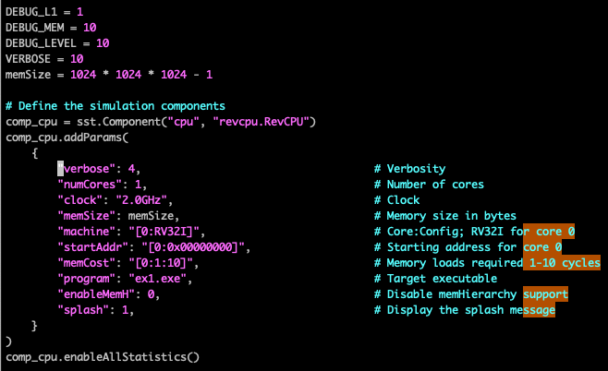
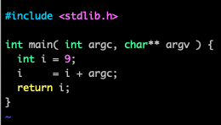
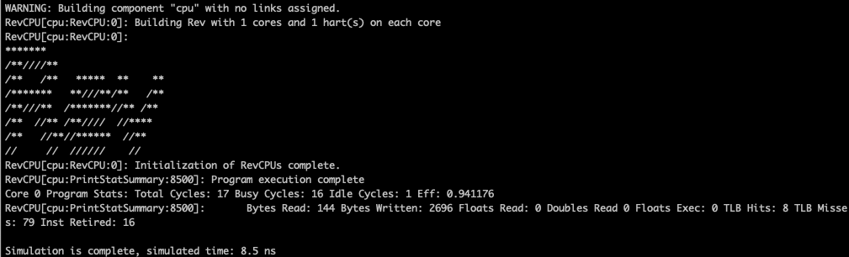
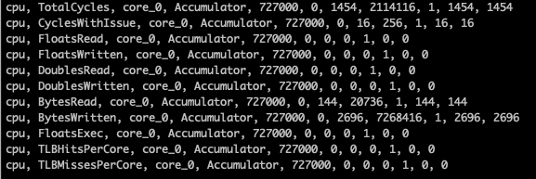
Running Sample Experiments (Example1)
$> riscv64-unknown-elf-gcc \
-march=rv32i -mabi=ilp32 \
-static -o ex1.exe ex1.c
$> cd example1/
$> sst ex1.py

Slide 40
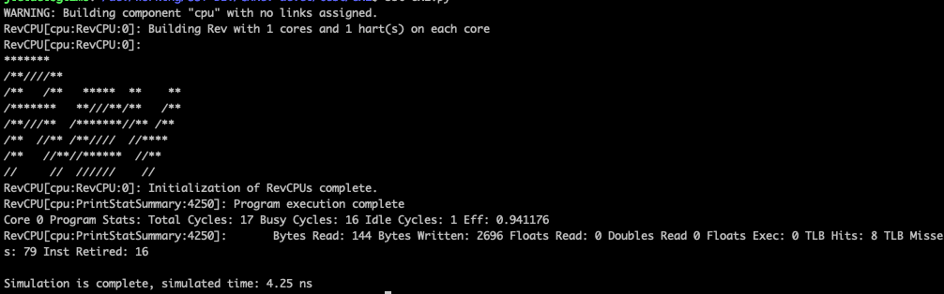
Running Sample Experiments (Example1) cont.
Change the Rev core clock frequency from 2.0GHz to 4.0Ghz
Rerun the example
$> sst ex1.py

Slide 41
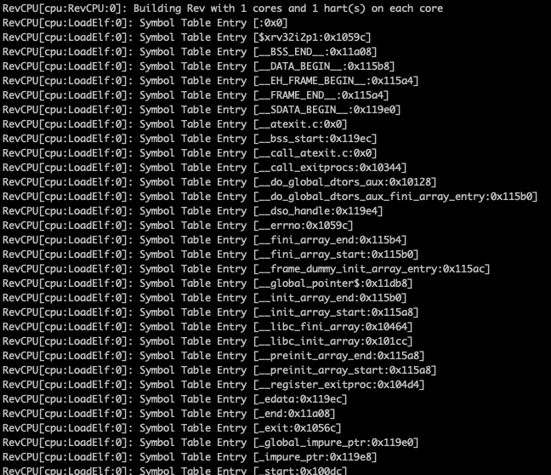
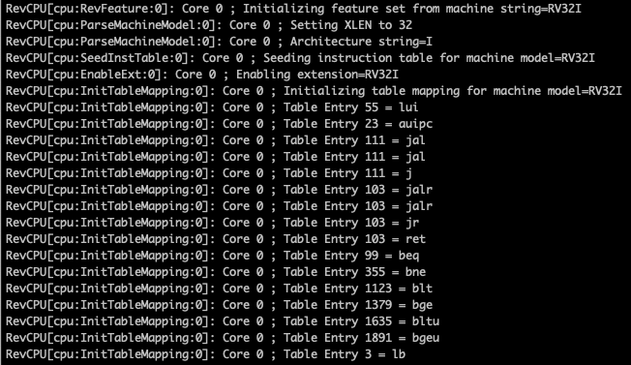
Running Sample Experiments (Example1) cont.
Change the Rev core verbosity from 4 to 6
Rerun the example
$> sst ex1.py

Slide 42
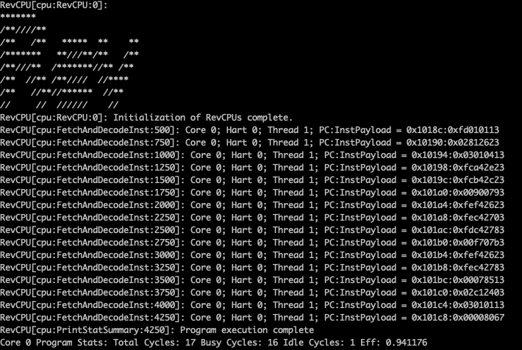
Running Sample Experiments (Example1) cont.
** doing this for long running simulations will decrease simulation performance and generate GB’s of textual output

Slide 43
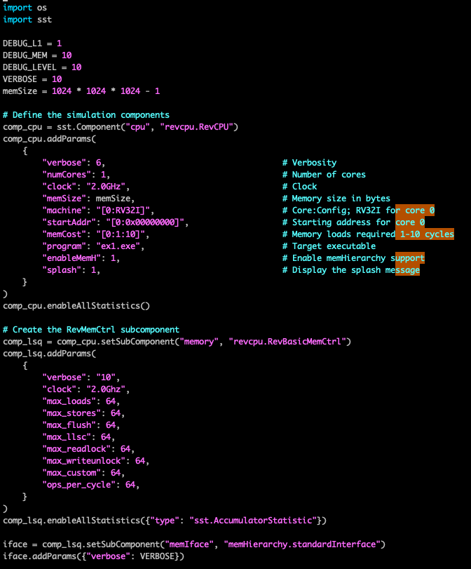
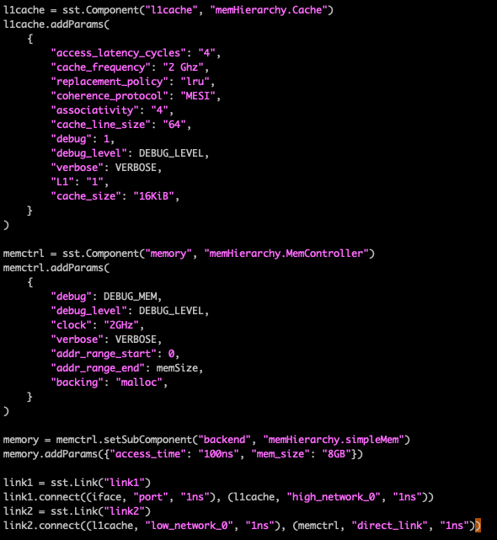
What if we want something more akin to a real system?
ex1_memH.py

Slide 44
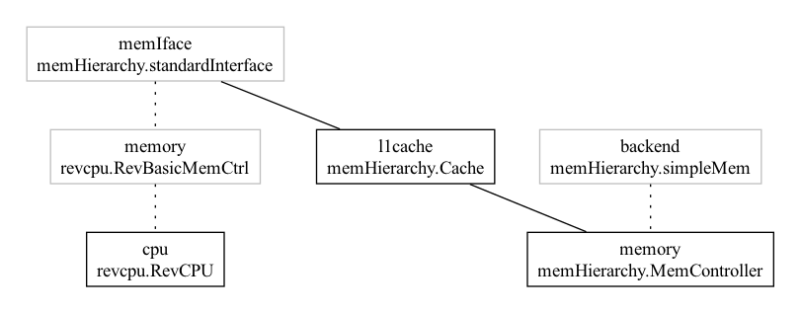
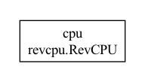
Simple memory versus cached simulation
ex1.py
ex1_memH.py

Slide 45
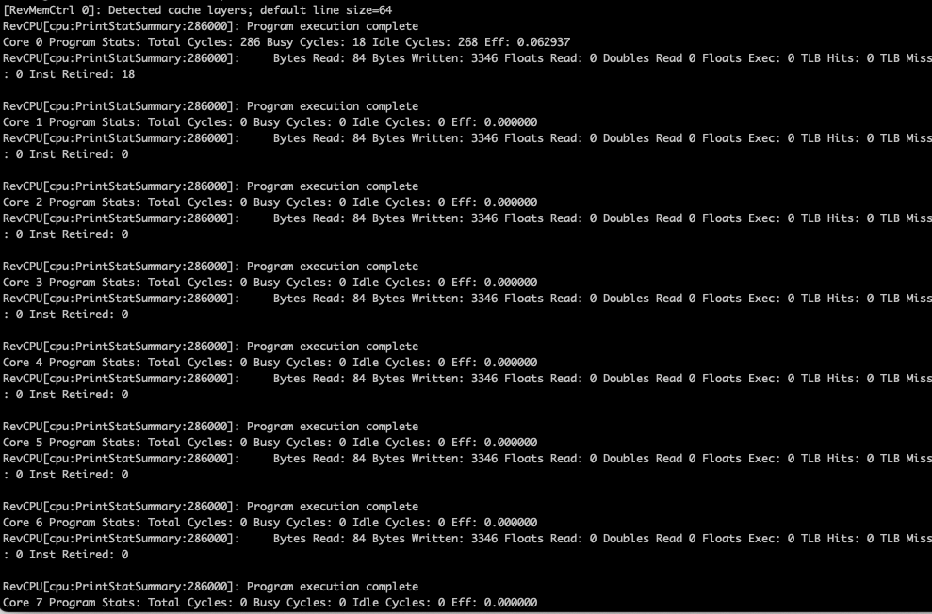
Rev Many Core Example
$> cd example2/
# -- Simple RV64GC example
$> sst many_core.py
# -- Scale it up with tightly coupled cores:
$> sst --model-options=“--numCores=8” \
many_core.py
SST Model options can be utilized for a variety of parameter passing methods that make constructing composable model inputs MUCH easier!
https://github.com/tactcomplabs/rev/blob/devel/test/rev-model-options-config.py

Slide 46
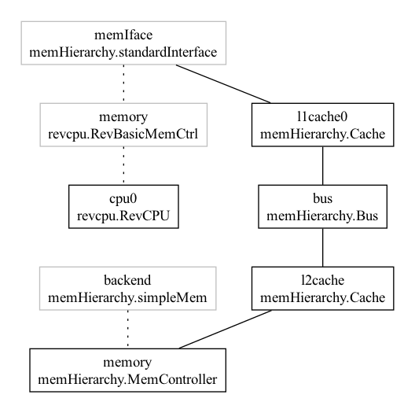
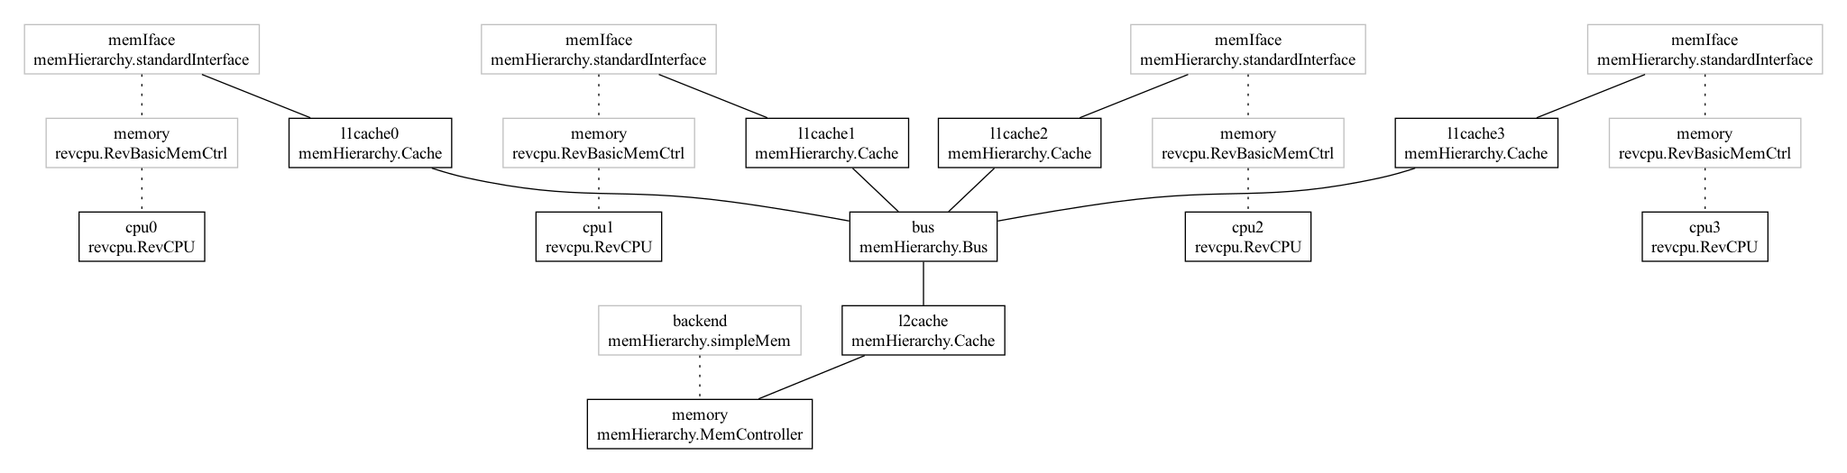
Rev Many Distributed Core Example
$> cd example2/
# -- Simple RV64GC example
$> sst many_core_dist.py
# -- Scale it up with distributed cores:
$> sst --model-options=“--numCores=4” \
many_core_dist.py

Slide 47
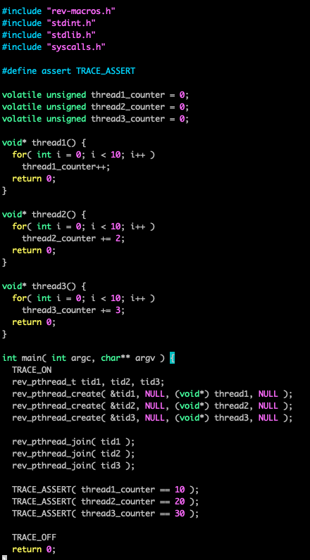
Rev Pthreads Example
$> cd example3/
# -- Simple Pthreads example
$> sst pthread.py
# -- Multi-hart example
$> sst --model-options=“--numHarts=4” \
pthread.py
# -- Multi-core + multi-hart
$> sst --model-options=“--numCores=4 \
--numHarts=4” pthread.py
This test enables internal tracing mechanisms that make debugging applications much easier within Rev

Slide 48
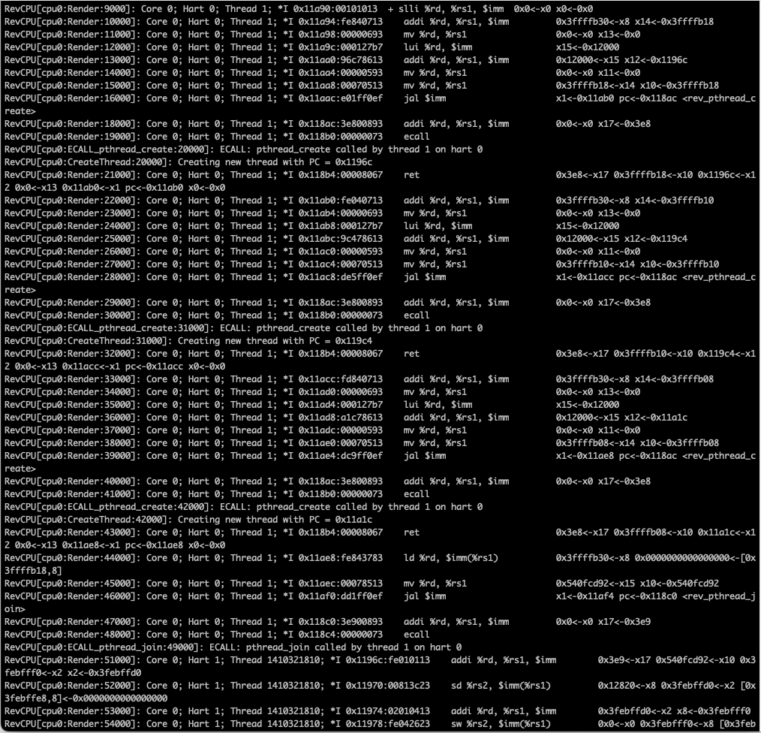
Rev Pthreads Tracing

Slide 49
Extending Rev with Custom Instructions
Extending Rev with new instructions can be done in two ways:
Modify Rev and add a new instruction table + implementation
Construct a coprocessor subcomponent model
For this tutorial, we will focus on the internal instruction tables
This is analogous to any standard RISC-V extension
Pro:
Requires minimal code efforts
Con:
Limits the extension to basic register-to-register operations and CSR manipulations
Does not permit asynchronous execution with the core (this method becomes a primary piece of the pipeline)

Slide 50
Steps to Modify Rev
Add an instruction extension header file with table entries and instruction methods
Add the encoding table values via the base factory class
Implement each new instruction method using the available class public members
Implement the new instruction as an available extension
Test it!

Slide 51
Add an instruction header
Add a new instruction header to be consumed by the Rev crack, decode and execution interfaces
~/include/insns/*
For this, we will create XIPDPS.h
Add the header to the list of all instruction headers (AllRevInstTables.h)

Slide 52
Add the encoding table
namespace SST::RevCPU {
class XIPDPS : public RevExt {
struct XIPDPSInstDefaults : RevInstDefaults {
XIPDPSInstDefaults() {
SetOpcode( 0b0001011 );
SetrdClass( RevRegClass::RegGPR );
Setrs1Class( RevRegClass::RegGPR );
Setrs2Class( RevRegClass::RegGPR );
}
};
std::vector<RevInstEntry> XIPDPSTable = {
XIPDPSInstDefaults().SetMnemonic("inst1 %rd, %rs1, %rs2").SetFunct3(0b000).SetFunct2or7( 0b0000000000 ).SetImplFunc(inst1),
XIPDPSInstDefaults().SetMnemonic("inst2 %rd, %rs1, %rs2").SetFunct3(0b000).SetFunct2or7( 0b0000000001 ).SetImplFunc(inst2),
};
public:
XIPDPS( const RevFeature* Feature, RevMem* RevMem, SST::Output* Output )
: RevExt( "XForza", Feature, RevMem, Output ) {
SetTable( std::move( XIPDPSTable) );
}
};
}
New instruction extension class!
Instruction default values
Register the extension with Rev
CXX Factory to construct individual instruction entries

Slide 53
Adding the instruction implementations
All instructions have the same interface args
class XIPDPS : public RevExt {
static bool inst1( const RevFeature* F, RevRegFile* R, RevMem* M, const RevInst& Inst ) {
R->SetX( Inst.Rd,
(R->GetX<uint64_t>(Inst.rs1) * R->GetX<uint64_t>(Inst.rs2) + 4) );
R->cost += M->RandCost( F->GetMinCost(), F->GetMaxCost() );
R->AdvancePC( Inst );
}
static bool inst2( const RevFeature* F, RevRegFile* R, RevMem* M, const RevInst& Inst ) {
R->SetX( Inst.Rd, (R->GetX<uint64_t>(Inst.rs1) |
R->GetX<uint64_t>(Inst.rs1) &
(~R->GetX<uint64_t>(Inst.rs2)))) );
R->cost += M->RandCost( F->GetMinCost(), F->GetMaxCost() );
R->AdvancePC( Inst );
}
Use the templated GetX/SetX interfaces to read/write registers in the correct bit space
Advance the instruction cost and the PC!
See ~/include/RevInstHelpers.h for more info on interfaces

Slide 54
Implement the instruction as an available extension
// RevFeature.h
enum RevFeatureType : uint32_t {
….
RV_XIPDPS = 1 << 23,
};
// RevFeature.cc
static constexpr std::tuple<std::string_view, uint64_t, uint64_t, uint64_t, uint64_t, uint32_t> table[] = {
…
{ "Xipdps", 1, 0, 1, 1, RV_I | RV_M | RV_ZMMUL | RV_ZAAMO |
RV_ZALRSC | RV_F | RV_D | RV_ZICSR |
RV_ZIFENCEI | RV_ZICNTR | RV_ZICSR |
RV_XIPDPS },
};
Just as in GCC and LLVM, Rev supports add “default” sets of extensions that automatically enable the correct flavor of RISC-V

Slide 55
Implement the instruction as an available extension cont.
// RevCore.cc
bool RevCore::SeedInstTable() try {
…
// XIPDPS Extension
if( feature->IsModeEnabled( RV_XIPDPS ) ) {
EnableExt( new XIPDPS( feature, mem, output ) );
}
return true;
} catch( ... ) {
return false;
}

Slide 56
Questions?
David Donofrio: ddonofrio@tactcomplabs.com
John Leidel: jleidel@tactcomplabs.com
Other resources:
https://github.com/tactcomplabs/sst-bench
https://github.com/tactcomplabs/sst-ext-tests
https://github.com/tactcomplabs/verilator-sst
https://github.com/tactcomplabs/sst-data

